Slide 1


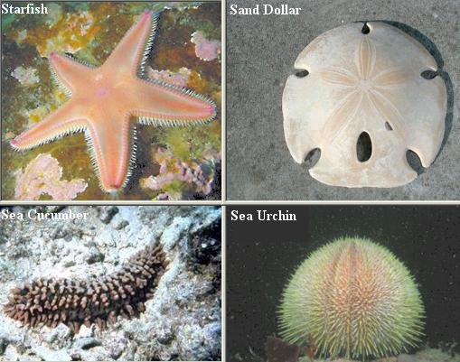
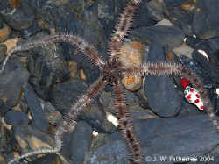
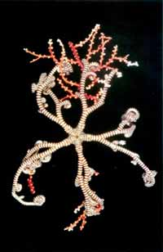
BASRAH UNIVERSITY
Faculty of Education for Pure Sciences
Biology Department
2025- 2026
Phylum Echinodermata
Presented By: Prof. Dr. Sabeeh H. AL-Mayah

Slide 2
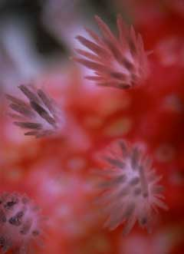
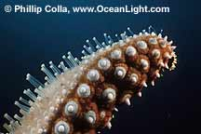
Phylum Echinoderms
Echinodermata are all marine, triploblastic unsegmented coelom of enterocoelous, head absent, contains 5300 species.
Haemal system enclosed.
Respiratory organs include dermal branchia, tube feet, respiratory tree and bursae.
Usually dioecious ,fertilization external, development indirect through free-swimming larval forms.
Regeneration of lost part.
Phylum has 3 unique features:
  pentagonal symmetry (bilateral in larvae).
  calcite spicules embedded in the skin, often partly fused.
  Tube feet (podia).
  No excretory organs.

Slide 3
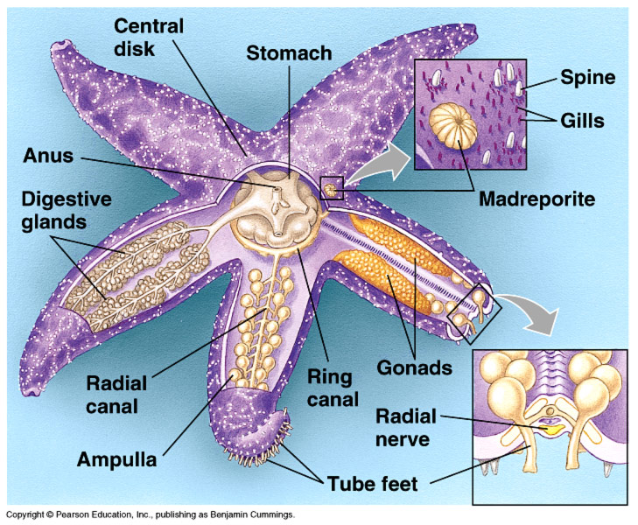
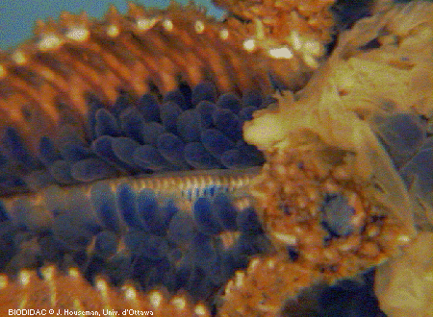
Water vascular system
Complex system of water filled canals
Extensions of tubed feet
Modification of the coelom
Ciliated internally

Slide 4
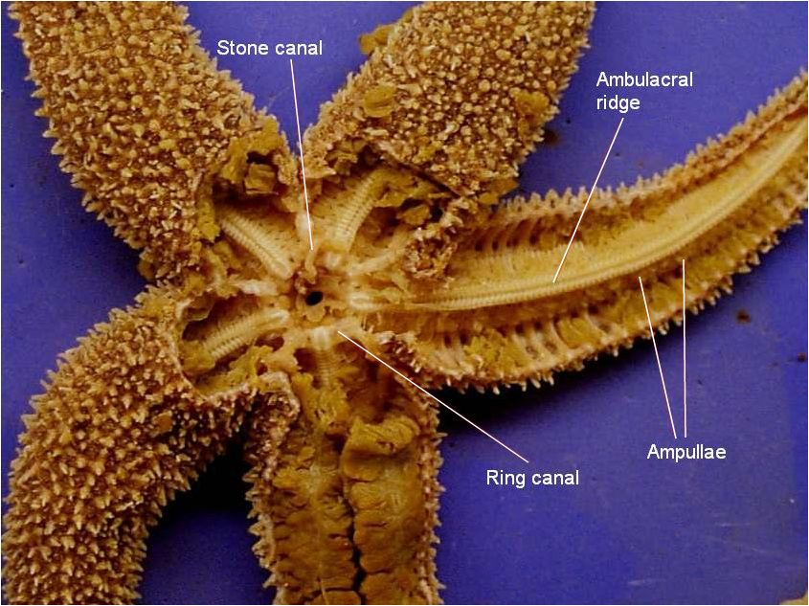
Ring canal that surrounds the mouth
Ring canal opens to the outside or body cavity through a stone canal and an opening called a Madreporite

Slide 5
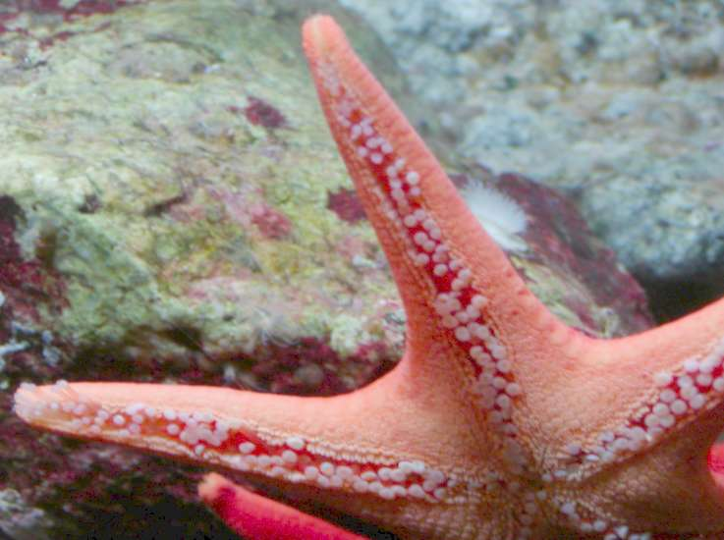
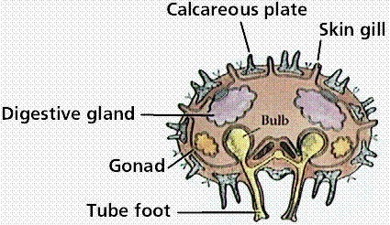
Tube feet
Extensions of the canal system
Usually emerge through openings in skeletal ossicles

Slide 6
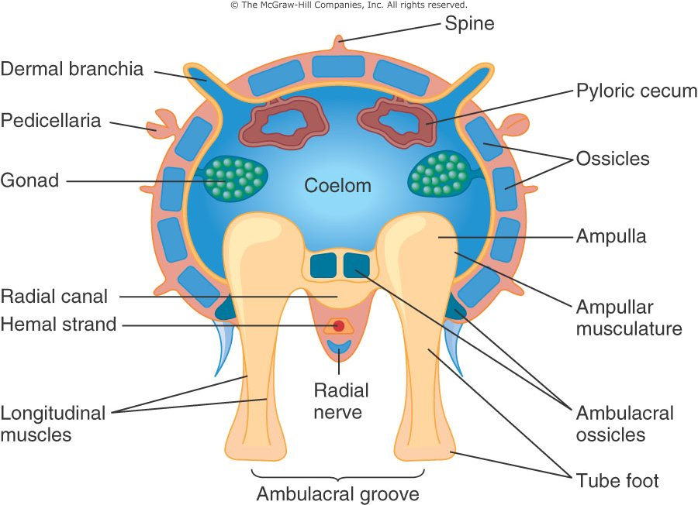
Suction cups

Slide 7
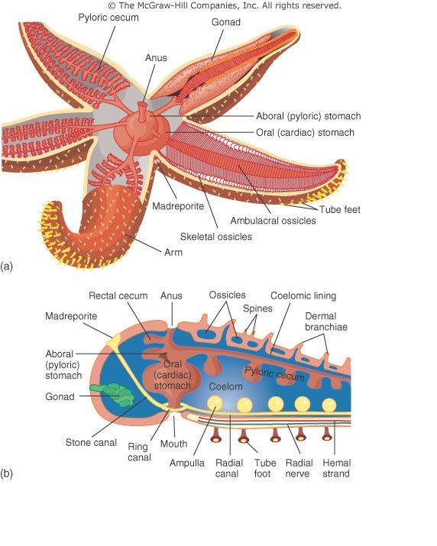
Oral opening- or mouth normally faced downward with moveable oral spines around it

Slide 8
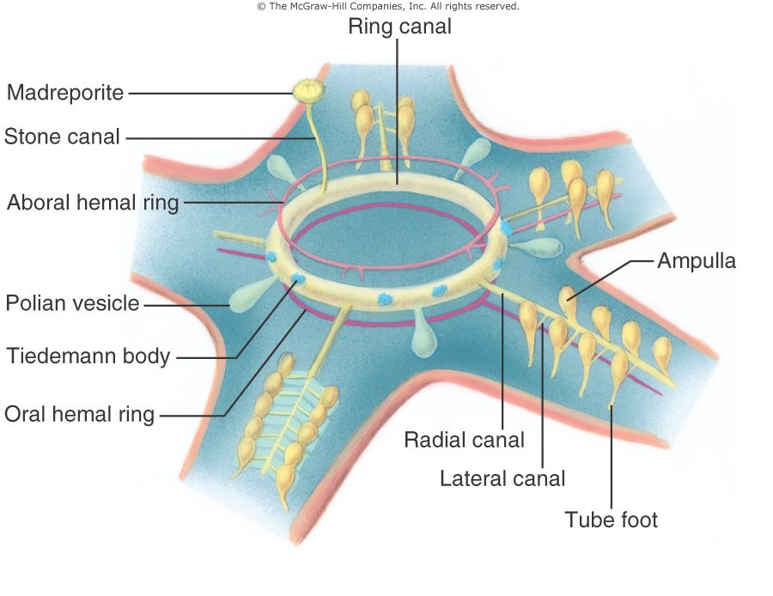
Madreporite serve to replace water lost from the WVS and equalize pressure
Ring canals associated with each arm
Lateral canals end at each tube feet

Slide 9
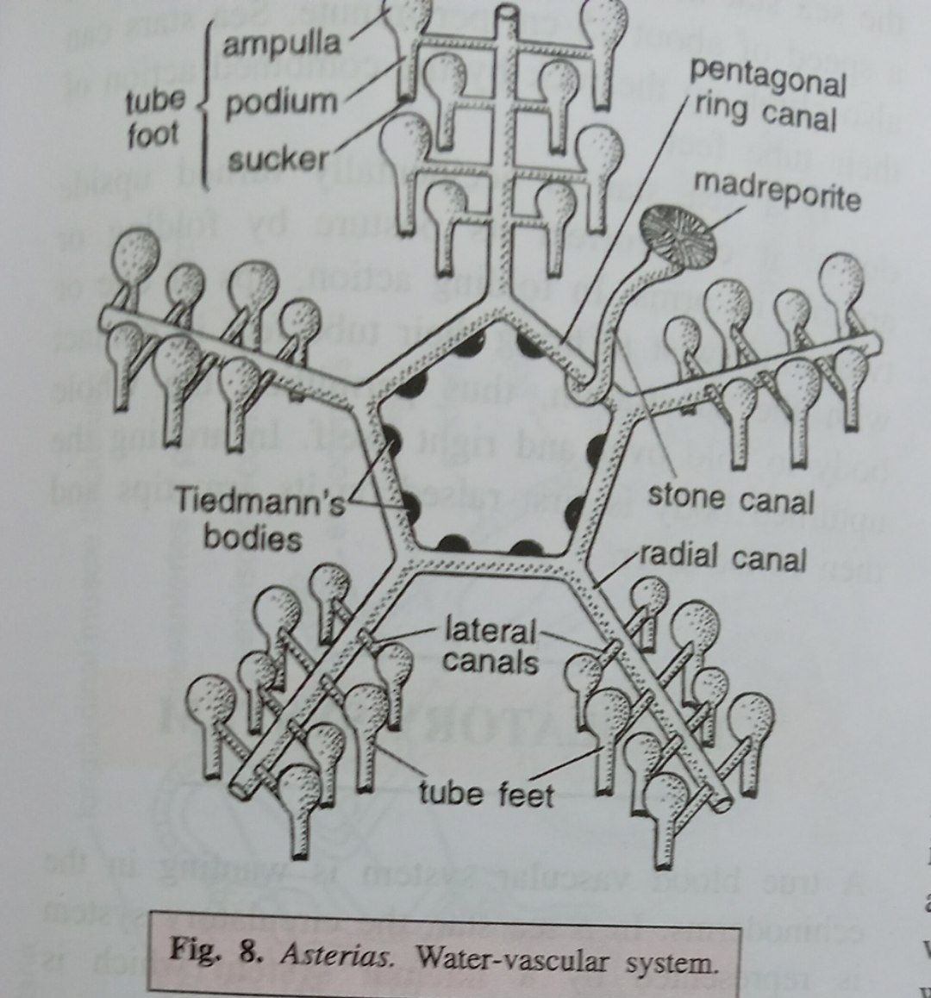

Slide 10
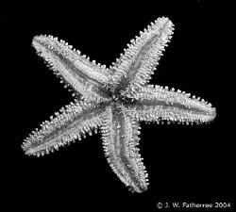
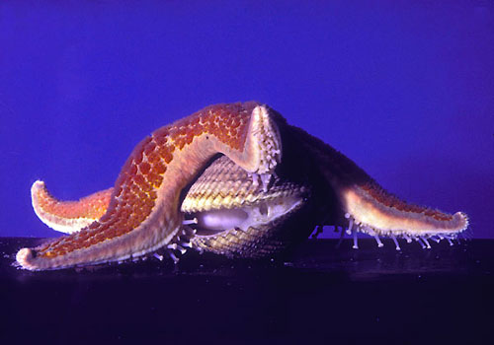
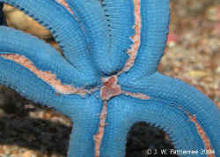
Water vascular system
Feeding
Attachment
Also permit exchange of respiratory gases and nitrogenous waste
Locomotion
Sensory function

Slide 11
Nervous system
Echinoderms have a diffuse nervous system with no “brain”
Nerve ring that encircles the mouth
Radial nerves that extend to each arm
Coordinate the functions of tube feet
Nerve net that coordinates the function of the body wall

Slide 12
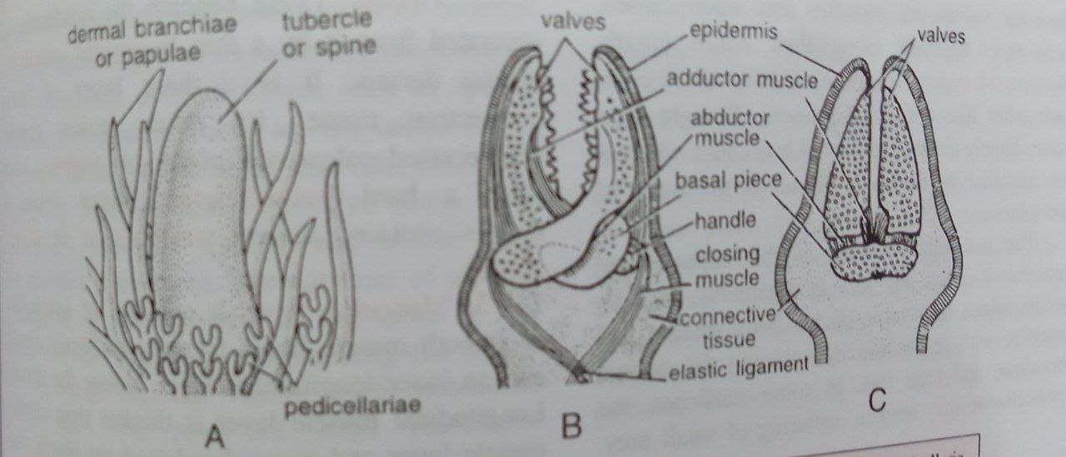

Slide 13
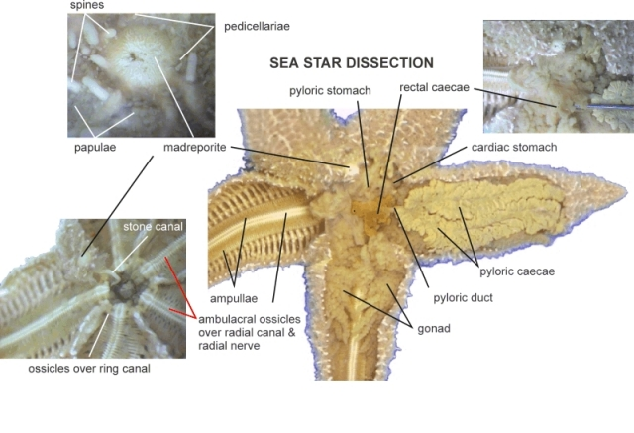

Slide 14
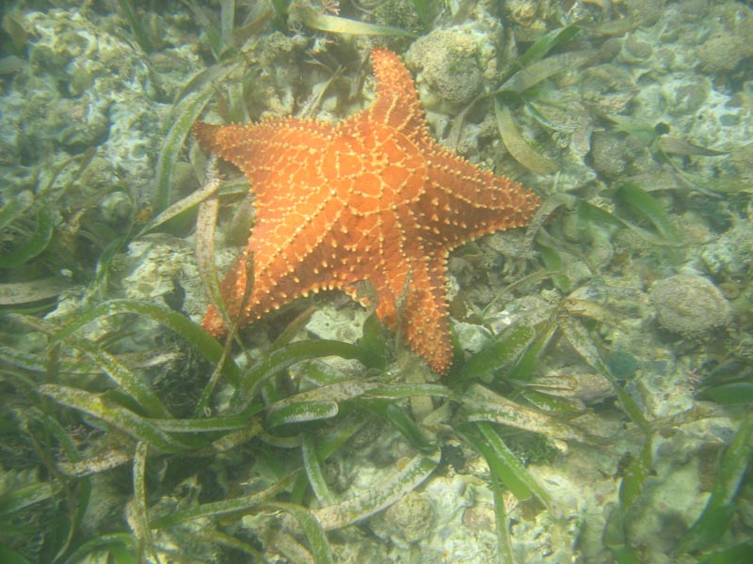
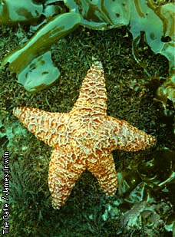
Class 1 Asteroidea
Sea stars
Arms 5 or more and not Sharply marked off from the central disc.
Tube feet in orally placed ambulacral grooves; with sucker.
Anus and madreporite aboral.
Pedicellariae present.
Free living, Slow-creeping, predaceous and scavengerous.
Ex. Asterias, Asterina and Solaster.

Slide 15
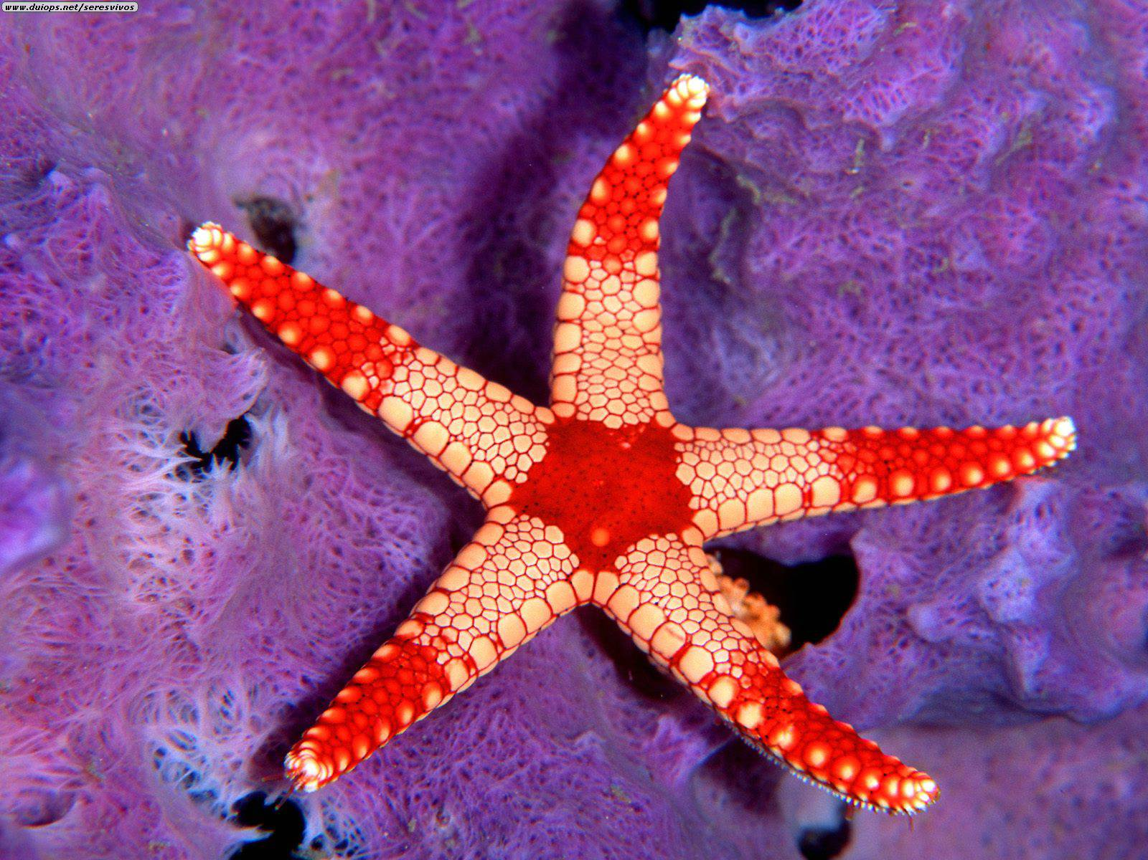
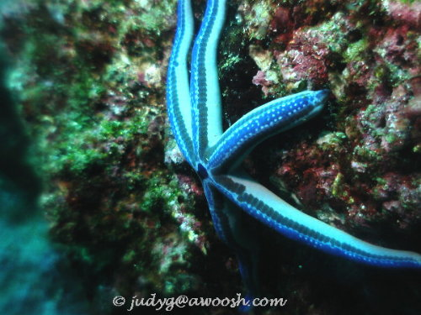
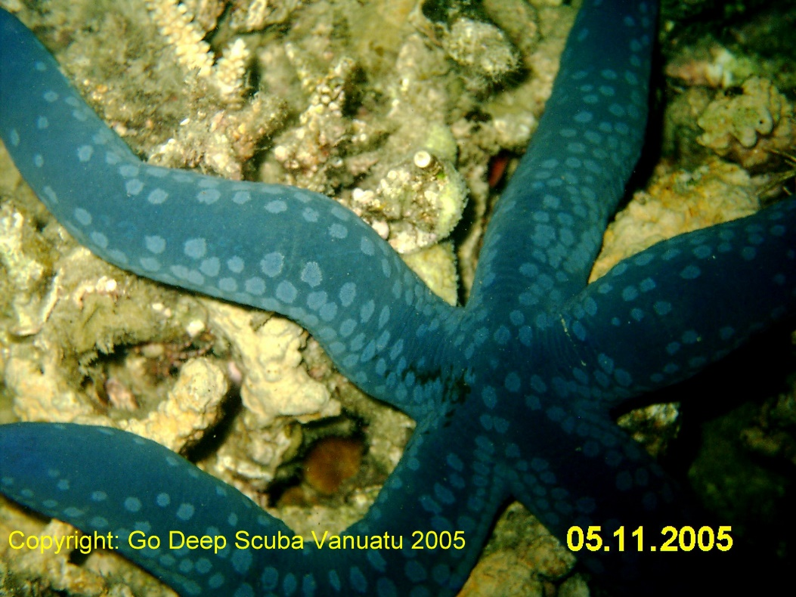
Sea Star
Various colors
1,500 species
Live on hard or muddy substrates.

Slide 16
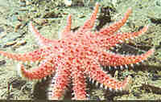
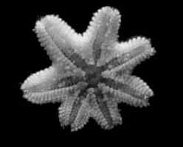
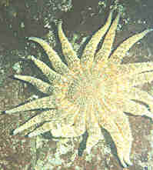
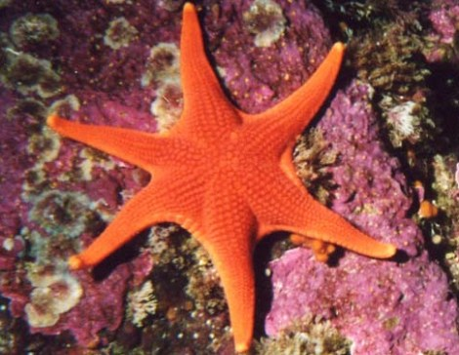
Exception to the rule
Some sea stars that have 6 or 7 arms
OR MORE!

Slide 17
Gonads
Sexes are separate, and discharge gametes into the sea water in response to chemo-stimulus of other gametes.
There are gonopores, ie 2 per arm in Asteroidea at the base of ambulacral grooves.
Gonads can be large - echinoid gonads almost fill the test and can be eaten as a delicacy.

Slide 18
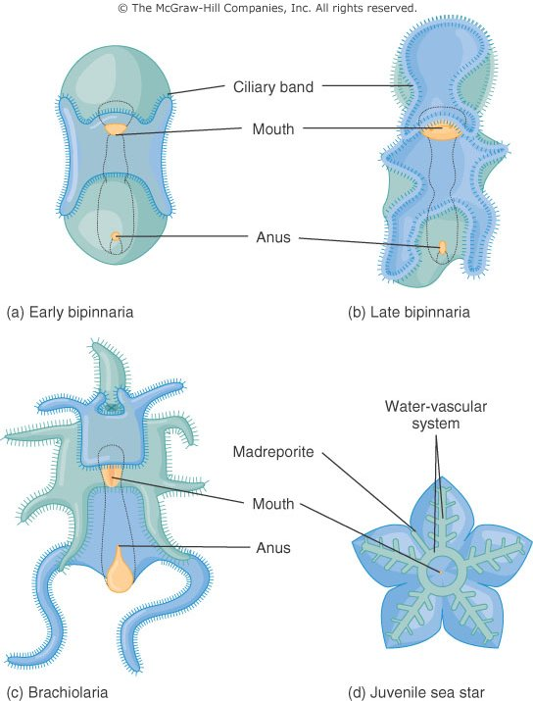
Development of a sea star

Slide 19
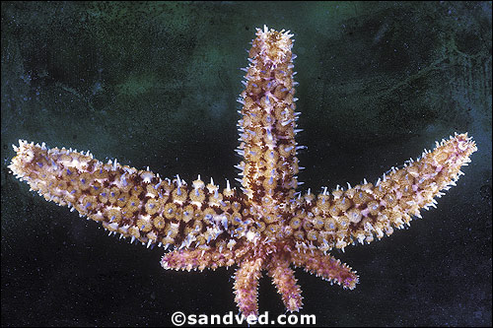
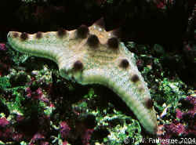
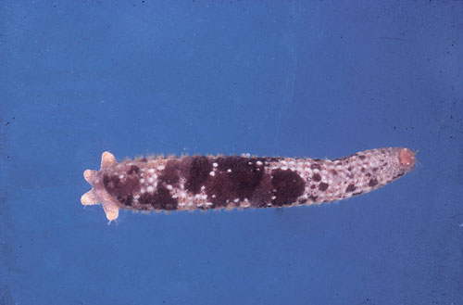
Regeneration
Arm
An entire sea star?

Slide 20
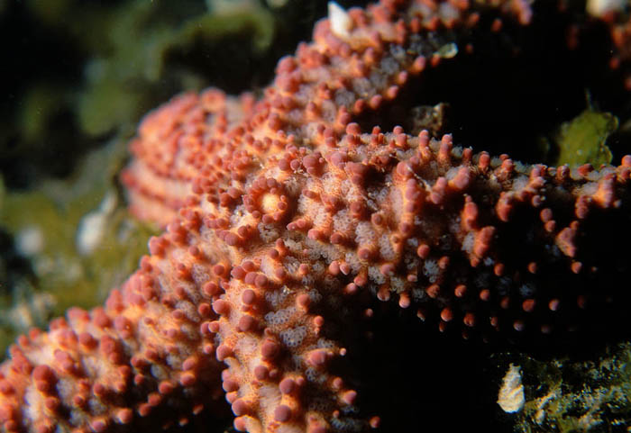
Madreporite
Is stated to allow pressure equalization and top up water supply to the WVS
There is something of a mystery here - the madreporite shows a continual water influx, but animals in which it is experimentally blocked appear to function and move normally
Is absent in crinoids

Slide 21
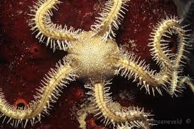
Class 2 Ophiuroidea
Brittle stars consist of a flat, circular body (disc) with five or more long thin arms that perform snakelike movements. These arms break of extremely easily, hence the name "Brittle stars". Arms sharply marked off from the central disc.
The sides of the arms are often spiny.
The mouth is situated at the lower surface and is surrounded by five toothed jaws.
Pedicellaria absent.
No anus .
Ambulacral grooves absent or covered by ossicles; tube feet without suckers.
Madreporite oral.
Most of the species are detritus feeders.
Ex. Ophiura and Ophiothrix .

Slide 22
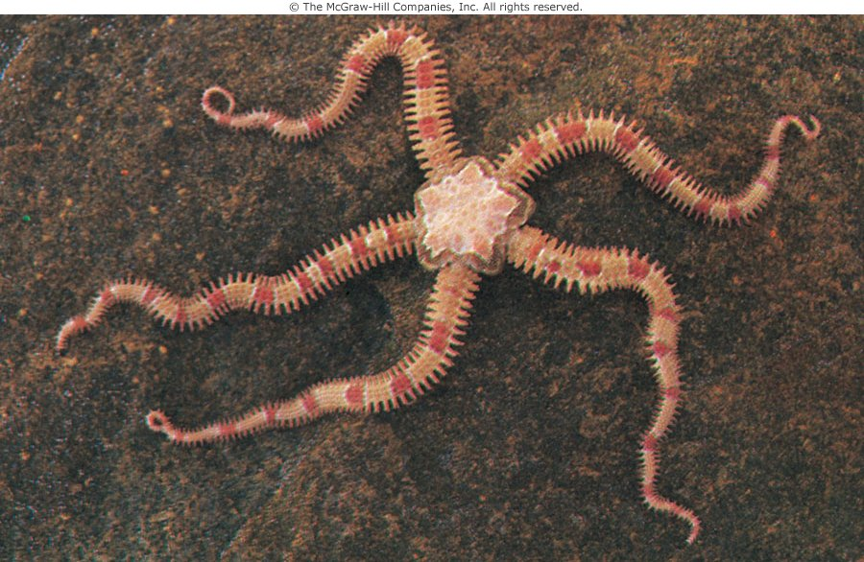
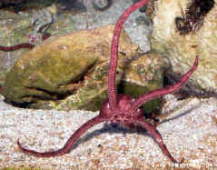
Are primarily detrital or filter feeders, raising their arms in a current to capture particulates

Slide 23
Class 3 Crinoidea
Crinoids or feather stars - almost certainly close to the ancestral form of the phylum.
Body attached during part or whole of the life by aboral stalk.
Mouth and anus are both on oral side.
Body is mainly made of ossicles.
10 arms with pinnules. Tube feet with out suckers ; no madreporite , spine and pedicellariae.
Ciliated ambulacral grooves on oral surface.
Ex. Antedon and Neometra (feather star)

Slide 24
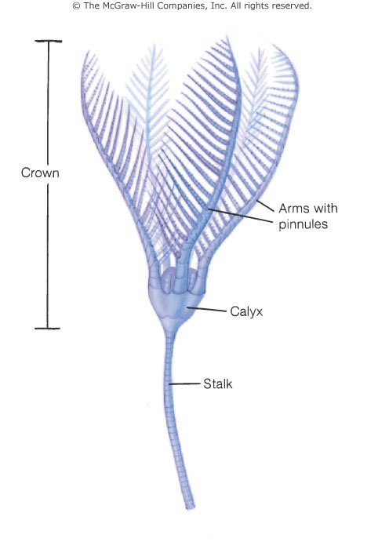
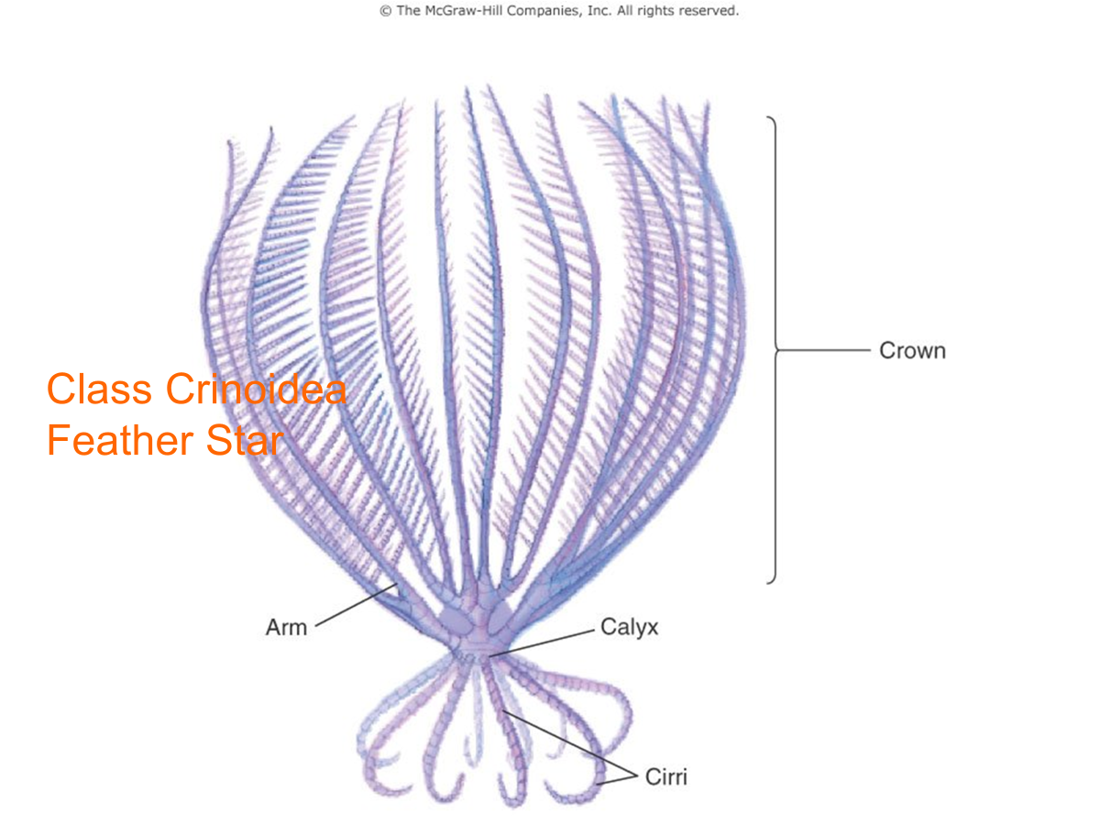
Class Crinoidea
Sea lily (Antedon )

Slide 25
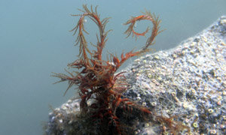
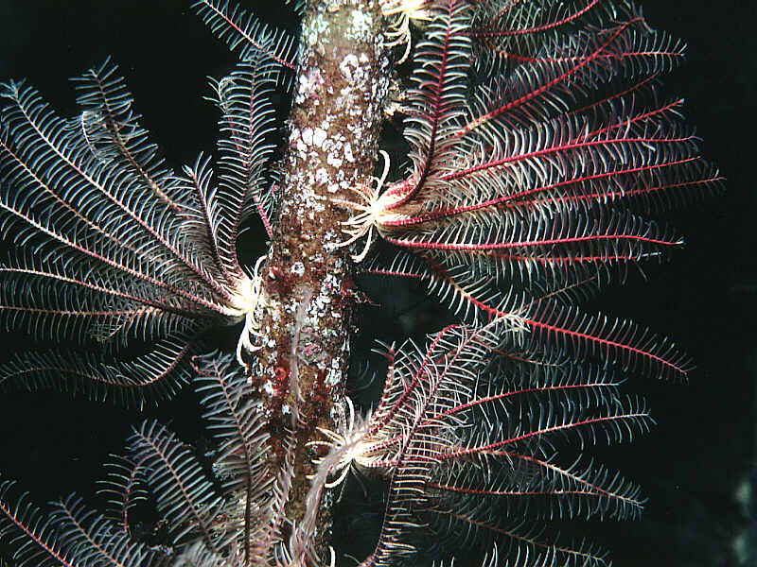
Free living crinoids - “feather stars”
Have >10 arms, often migrating vertically to filter feed in shallow waters at night, usually by crawling
Antedon: A. bifida is found in UK waters. This can swim actively.

Slide 26
Class 4 Echinoidea- Sea Urchin
Body discoid, oval or semi-spherical and with out arms.
Skelton or test compact bearing movable spines and three-jawed pedicellariae.
Ambulacral grooves covered by ossicles; tube feet with sucker.
Chewing apparatus or Aristotle’s Lantern with teeth.
Ex. Echinus and Diadema .

Slide 27
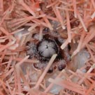
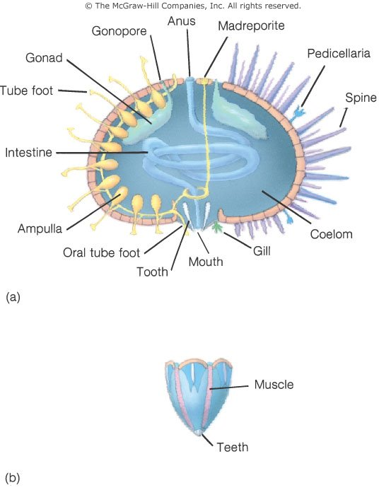
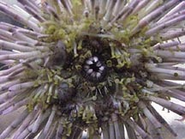
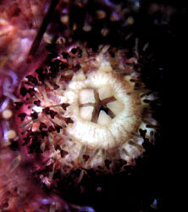
The mouthparts are unique, 5-radiate (of course!), known as Aristotle’s Lantern. This involves 5 continually growing chisel teeth, each with 8 supporting skeletal pieces. This gives the teeth remarkable versatility in their action.

Slide 28
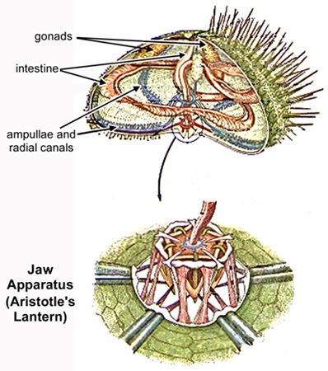
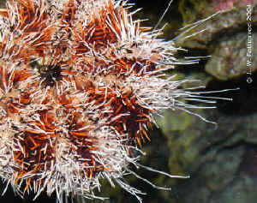
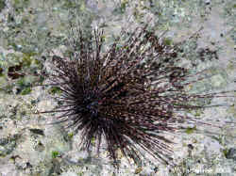
Are all herbivores, preferring macro-algae so are mainly found in sunlit waters.
They can be highly effective grazers, creating “urchin barrens” devoid of algae

Slide 29
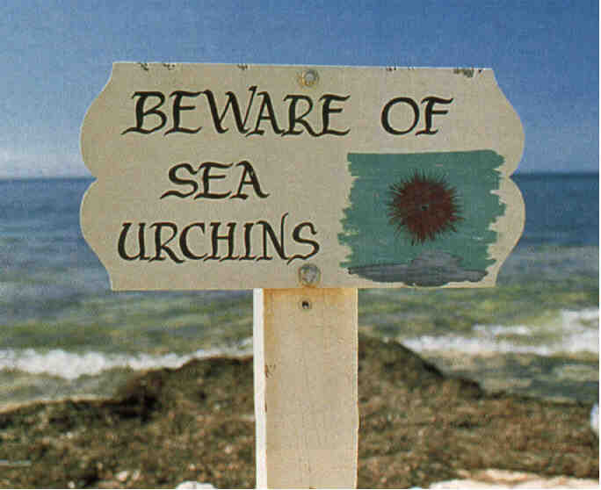
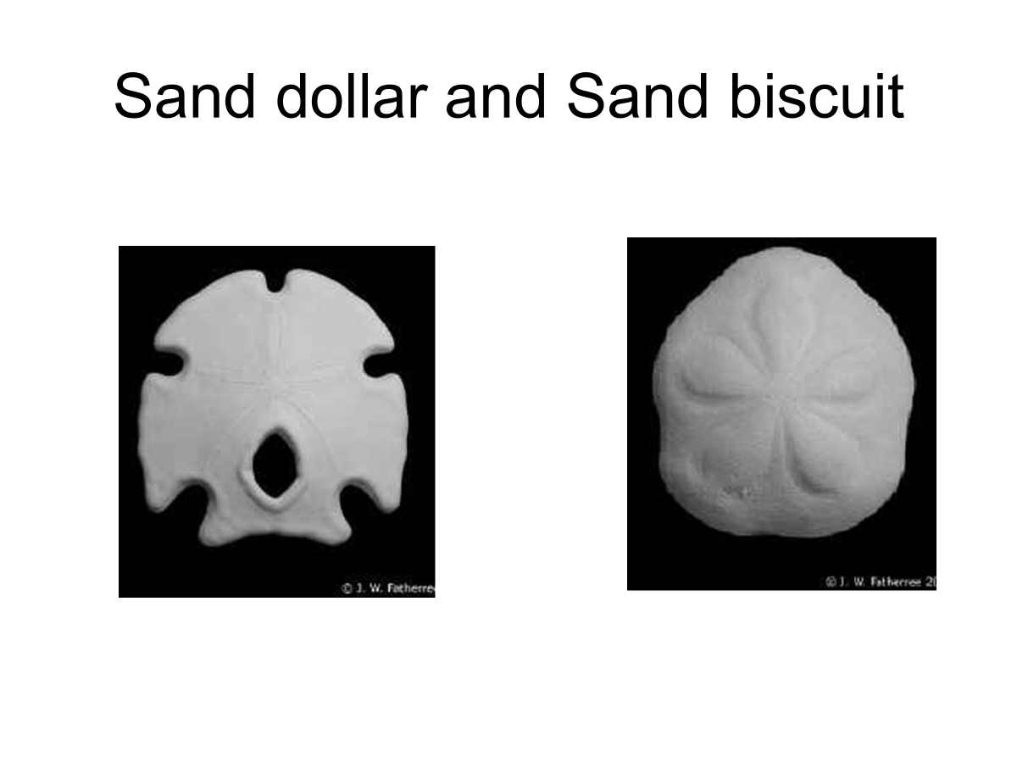
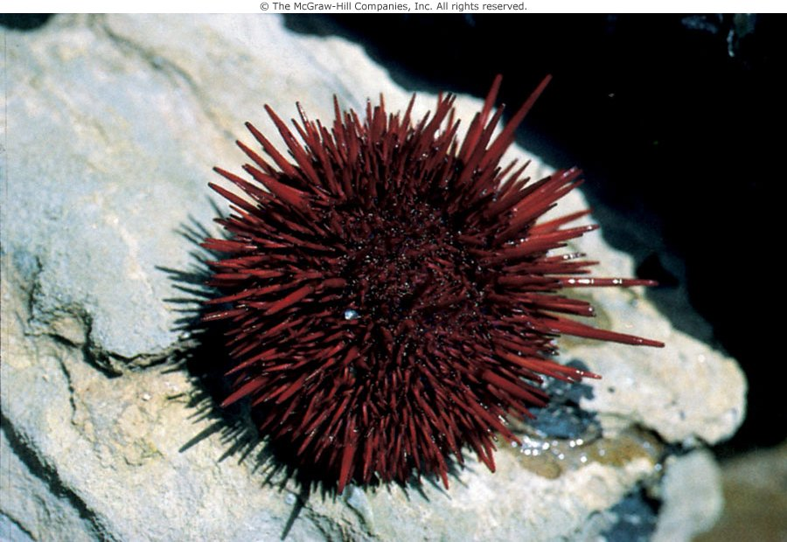

Sea Urchin test

Slide 30
Class 5 Holothuroidea- Sea Cucumbers
No Arms , no spine
Elongate along oral-aboral axis body wall leathery
Lie on flatten ventral side
They have no calcitic skeleton.
Most are immobile and lie on the seabed rolling back and forth with the swell. Some have limited mobility using their tube feet.
Mouth anterior, surrounded by tentacles.
Ambulacral grooves concealed; tube feet with suckers.
Usually with respiratory tree for respiration.
Ex. Thyone and Holothuria

Slide 31


Holothuroidea
They have 2 odd defensive strategies:
  Squirting a stick goo from Cuvierian glands.
  Voiding their entire intestines.
  Sea cucumber

Slide 32

They mainly feed on detritus, collected by oral tentacles which are derived from tube feet.
Oxygen exchange is performed using gills inside their anus
Hmm…

Slide 33
Echinodermata Larval Stages
Asteroidea : Bipinnaria
Ophiuroidea : Ophiopluteus
Echinoidea : Echinopluteus
Holothuroidea : Auricularia
Crinoidea : Doliolaria

Slide 34
Thank you for your attention!

